Slide 1
Evaluating the Library of Virginia’s
Summer Reading Program
Kimberly S. Cowley, Ed.D., Edvantia
Enid Costley, Library of Virginia
July 31, 2013
Notes:
Welcome, and thanks for taking the time to participate in this webinar, which focuses on the Library of Virginia’s 2013 Summer Reading Program which is currently underway, and the evaluation of this program. We’ll be spending the next 15 or 20 minutes sharing some information about this study, and then will have 10 to 15 minutes for questions.

Slide 2


Housekeeping
Notes:
But, first some housekeeping details.
We have muted all phones.
If you have questions or comments, please type them into the chat box during the webinar.
We will address questions toward the end of the webinar.
The webinar will be recorded and posting links on the Edvantia and LVA websites.
We will provide the Powerpoint and a summary of the questions/answers to all registrants.
Clip art images from Google Images.

Slide 3
Virginia Public Libraries
91 public library systems in Virginia
358 public library buildings
Notes:
We would like to welcome you all to this webinar – I know we have some guest from other states participating so I though I would give a quick overview of Virginia and the summer reading program.

Slide 4
Virginia Population
8,001,024 population
509,625 or 6.4% under 5 years
511,849 or 6.4% 5 to 9 years old
Notes:
http://factfinder2.census.gov/faces/tableservices/jsf/pages/productview.xhtml?src=bkmk – 2010 Demographic Profile Data. Projected population for Virginia is 8,185,867 or growth of 2.3%
Bibliostats for 2012 and 2011

Slide 5
Summer Reading Program
177,121 children and 27,235 teens or a total of 204,356 (2012 summer reading program)
171,168 children and 26,699 teens or a total of 197,867 (2011 summer reading program)

Slide 6


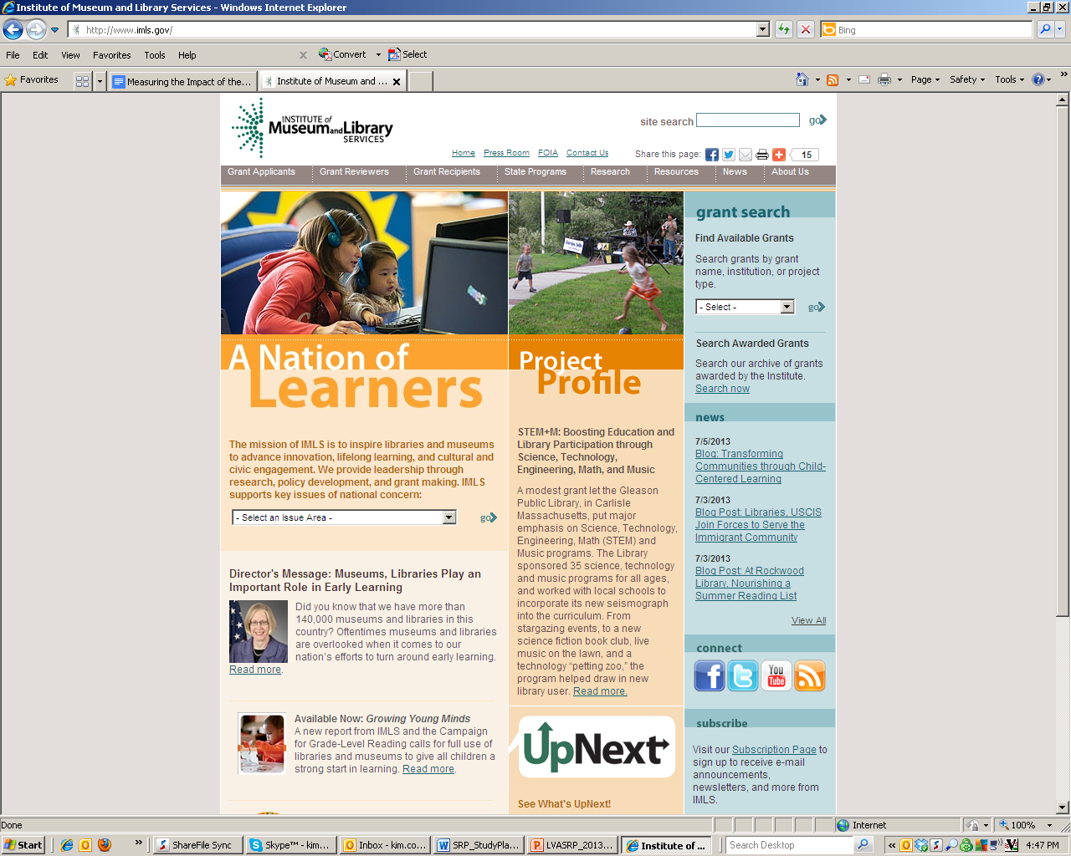

About the Summer Reading Program
Purpose
Goals
Funding
Notes:
The purpose of the SRP is to encourage reading and help prevent the loss of youth’s reading skills during the summer.
Typical goals of for summer reading program include: (1) encourage youth to continue reading during the summer; (2) provide safe and fun activities for youth to enjoy during the summer; and (3) build healthy communities.
The Library of Virginia uses funds from Institute of Museum and Library Services support the summer reading program. This includes purchasing training manuals, promotional materials and online tracking system (Evanced Summer Reader)
Photo from Google Images: learn.esu10.org

Slide 7






Partners and Roles
Notes:
Carol Adams , Assistant Director, Library Development and Networking at LVA and Enid Costley , Children’s and Youth Services Consultant for the LVA.
Participating library systems: Approximately 45 public library systems (or 205 outlets- this includes bookmobiles) across VA participating (includes county, city, and regional) (can we do a map graphic???)
Clients or patrons: Name three categories of youth: young children (birth to age 5), children (ages 6 to 12), teens (ages 13-17)
Funding for the study is being provided by Institute of Museum and Library Services (IMLS)
At the Virginia Department of Education, we are working with Bethann Canada, Director, Office of Educational Information Management; and Sarah Susbury, Director, Office of Test Administration, Scoring & Reporting,
May Masad of Evanced Solutions, which is responsible for the online data tracking system being used to secure SRP participation data.
Dr. Kim Cowley, Dr. Hsiang Ho represent Edvantia, which is conducting the evaluation of the LVASRP. I am the Director of the Program Evaluation Center at Edvantia as well as the project director for this evaluation, and Hsiang is the primary data person. She also will be the primary liaison with ANALYTICA, our analytic partner for the evaluation.
Key staff there will include: Dr. Herb Turner and Dr. (?) Annette Turner of ANALYTICA

Slide 8
Evaluation Design
Compares reading outcomes of SRP participants with those of a group of nonparticipants
Securing data from Evanced Solutions and Virginia Department of Education
Site visits to a sample of participating libraries
Longitudinal follow-up
Notes:
This is a quasi-experimental design, in that we are not randomly assigning students to either the treatment or comparison groups. It allows us to look at changes in reading outcomes for SRP participants as well as what reading outcomes look like for a similar group of youth who do not participate in the program.
Will use propensity score matching to select youth from the same school divisions who have similar student-level attributes (gender, age, achievement level, disadvantaged status).
We will secure SRP participation data from Evanced Solutions this fall and again in the fall of 2014. This will include the titles of the books read, and things like number of books or chapters read, number of hours or minutes read. What’s not in the system, but we hope to work with LVA to secure, is the Lexile reading levels for as many books as possible.
We will secure student-level demographic and achievement data from the Virginia Department of Education. We need the demographic data so we can form the comparison groups. The achievement data will include the Phonological Awareness Literacy Screening or PALS for PreK-Grade 3, and the Virginia Standards of Learning or SOLs in reading for Grades 3-11.
During the summer of 2014, we will visit a sample of five or six participating libraries—those showing most promising outcomes from preliminary findings—and observe library facilities, SRP implementation, and talk with key library staff.
And, we will conduct a follow-up study with a subset of SRP participants by looking at their achievement outcomes in the 2014-15 school year, after either one or two years of participation in the SRP. We will focus that investigation on youth in grades 4 through 6 during the 2012-13 school year, so that we have students for whom similar SOL data will be available across three years (before entering high school and moving from SOL to end-of-course exams).

Slide 9
Evaluation Questions
How to children and teens participate in the SRP?
What influence does the SRP have on participants’ reading outcomes?
Do children and teens of different backgrounds experience the program and its outcomes differently?
What is the long-term impact of participation in the SRP on children and teen reading outcomes?
Notes:
These are the primary questions that will guide our study; there are numerous subquestions embedded within each.

Slide 10
Protection of Data
Contracts
Memo of Understanding
Reading Tracking System Privacy Policy
Restricted-Data Use Agreement
Processes
Notes:
Contracts: LVA with Evanced Solutions, LVA with Virginia Department of Education, LVA with Edvantia
MOU: all participating public libraries with LVA
Privacy Policy: all parents who sign up their children in the SRP
R-DUA: agreement between LVA and VADE, but with signed affadavits of all individuals (including Edvantia and ANALYTICA) who will access the VADE student demographic and achievement data.
Process: Edvantia will submit a request for the data each fall to VADE; those data will be made available from VADE using a file sharing service of their choosing, these data will be available to secure for a limited time period. Edvantia will then match that data with SRP participation data, and then create a unique identification number. Personally identifying info such as name and birthdate will then be removed from the comprehensive data set that will be used for subsequent analyses. A code key with the personally identifying variables and the unique identification number will not be shared outside Edvantia.
To further protect this information, all data files from the VADE will be stored only on Edvantia’s servers (no portable media), and all of these files will be deleted from the servers and backup mechanisms at the close of the project.

Slide 11
Key Products
Preliminary evaluation report
Annual evaluation report
Final evaluation report
Annual webinars
Presentations
Notes:
The 2013 report will cover preliminary findings from the library survey as well as the participation data for summer 2013.
The annual evaluation report will include the first analysis of 2013 participation data coupled with achievement data (from 2012-13 as a baseline and from 2013-14 after the summer treatment).
The final evaluation report will include a longitudinal look at long-term outcomes, using achievement data from 2014-15.
We will be hosting annual webinars in December 2014 and December 2015 to share findings from our evaluation.
We will be collaboratively submitting proposals at appropriate conference venues.

Slide 12
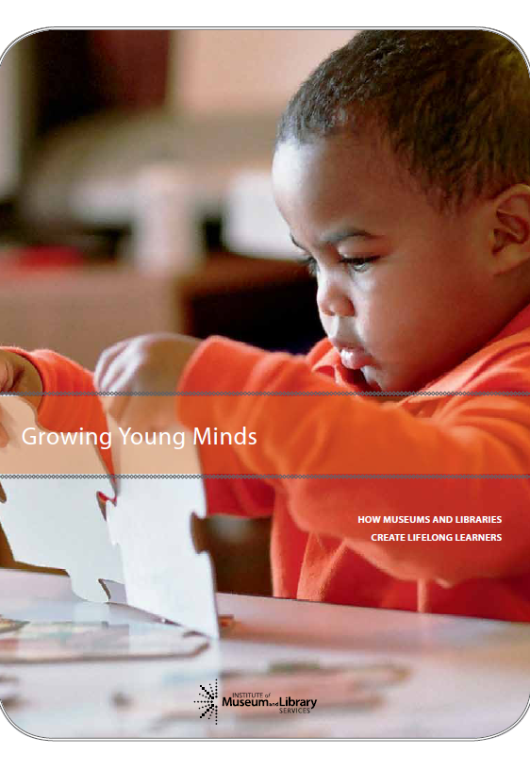

Alignment with National Efforts
Growing Young Minds: How Museums and Libraries Create Lifelong Learners
Campaign for Grade-Level Reading
Notes:
The growing young minds report was released in June 2013 by the Institute of Museum and Library Services. Wanted to mention briefly how the current SRP study fits within the 10 key ways in which museums and libraries currently support community efforts with children’s learning. That is the sixth entry, that of addressing the Summer Slide. Further, some of our evaluation questions map onto several identified in the report’s agenda for future research. For example, impact of SRP on learning outcomes, lost-lasting effect of the SRP, differential outcomes for youth, etc.
And, wanted to mention the common interest with the national Campaign for Grade-Level Reading, a collaborative effort by foundations, nonprofit partners, states ,and communities across the nation to ensure that more children in low-income families succeed in school and graduate prepared for college, a career, and active citizenship. Their goal is to increase the number of kids reaching proficiency in reading by Grade 3 by the year 2020 by tackling school readiness, chronic absence, and summer learning loss.

Slide 13
Q&A
Reminders
Questions from chat box
Notes:
PPT and summary of Q/A will be provided to all webinar registrants.
A recording of the webinar will be posted on web sites for Edvantia and LVA.
Questions? Please post them in the chat box.
Whatever questions we don’t have time to cover today will be addressed in the forthcoming summary.
So, we’ve been culling the questions from the chat box, so let’s start addressing those.
MELANIE AND ZAC WILL HAVE BEEN PULLING THESE AS THEY APPEAR, GROUPING THEM INTO SOME LOGICAL CATEGORIES, AND WILL SHARE THEM WITH KIM/KRISTINE, who will try to provide answers.
Should have about 10 minutes for Q/A.

Slide 14

Contact Information
kim.cowley@edvantia.org
304-347-0418
enid.costley@lva.virginia.gov
804-692-3765
Notes:
Here’s contact information for myself and Enid; please get in touch with us if you want more information.
And, finally, thank you so much for your participation in this webinar!

